Slide 1
Presentation on Industrial Training Project

Slide 2
Project on Sentiment Analysis
Presented by :
Sudhanshu, Shivam
Roll No: 1219314, 1219300
B.Tech. C.S.E. (7th Sem.)
Seth Jai Parkash Mukand Lal Innovative
Engg. & Technology Institute, Radaur. (Yamunanagar).

Slide 3
What is Python?
Python is a Programming Language Developed by Guido Van Rossum in 1991.
Python should be a beginner’s Programming Language.
Python is a Interpreted Language.
Python is highly readable language than other languages.
Python is Object Oriented Language.
Python is a Interactive Language (Command Line).

Slide 4
Scope and Use of Python
Python Programming Language is must for Linux Admin.
Python is used for AI (Artificial Intelligence).
Python is used in Database Programming.
Python is used to develop complex Websites and Systems.
Python is used for Hacking Purposes also.
Python Programmers are most demandable in IT industry these days and get paid more.

Slide 5




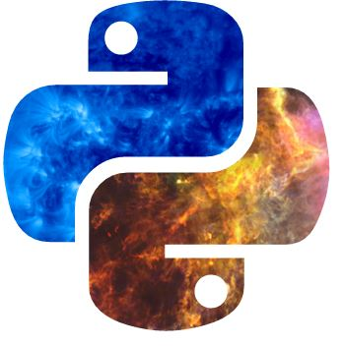





Companies Using Python

Slide 6
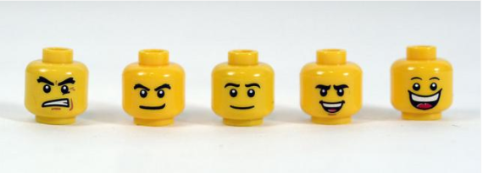
About Project
What is Sentiment Analysis? Why it is Necessary ?
Sentiment analysis is also known as opinion mining .
Sentiment analysis is extremely useful in social media monitoring as it allows us to gain an overview of the wider public opinion behind certain topics.

Slide 7
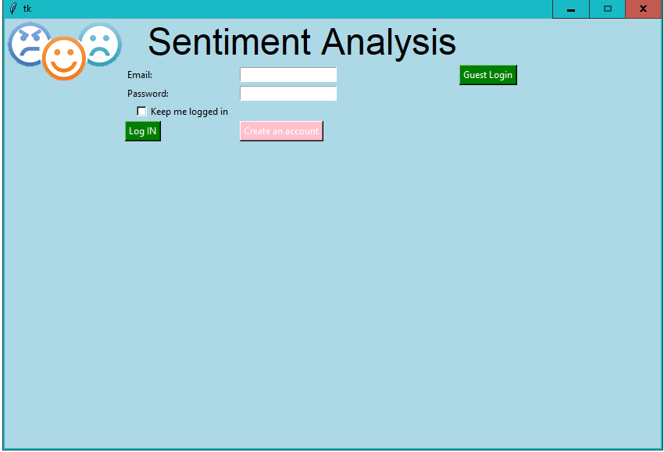
Login Page for the application

Slide 8
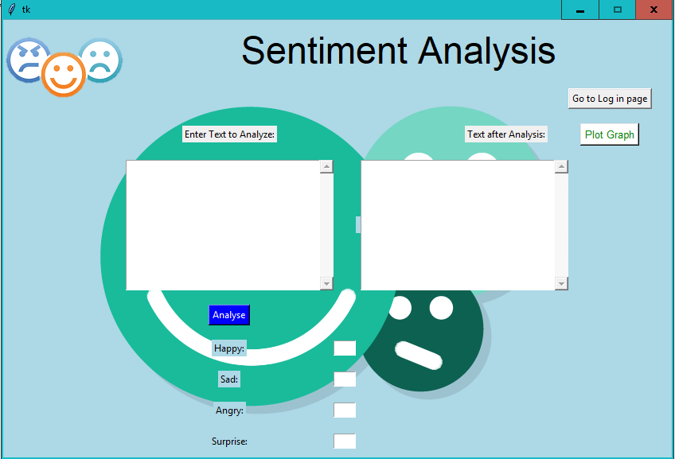
Guest Login

Slide 9
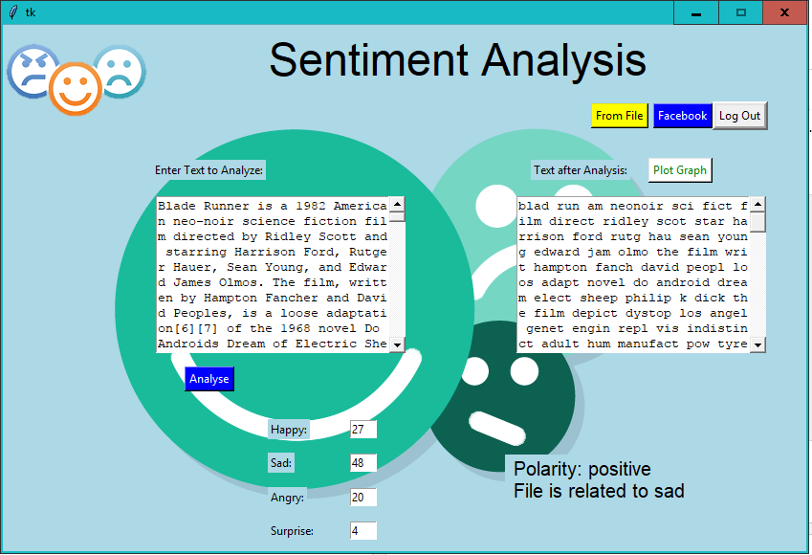
Data Analysis

Slide 10
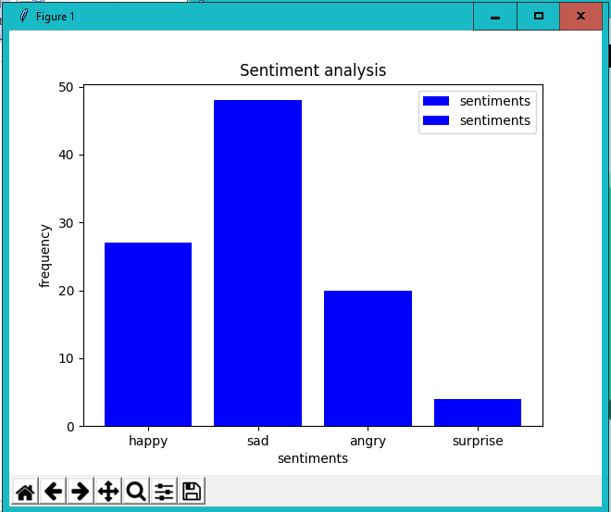
Graphical Representaion of result

Slide 11
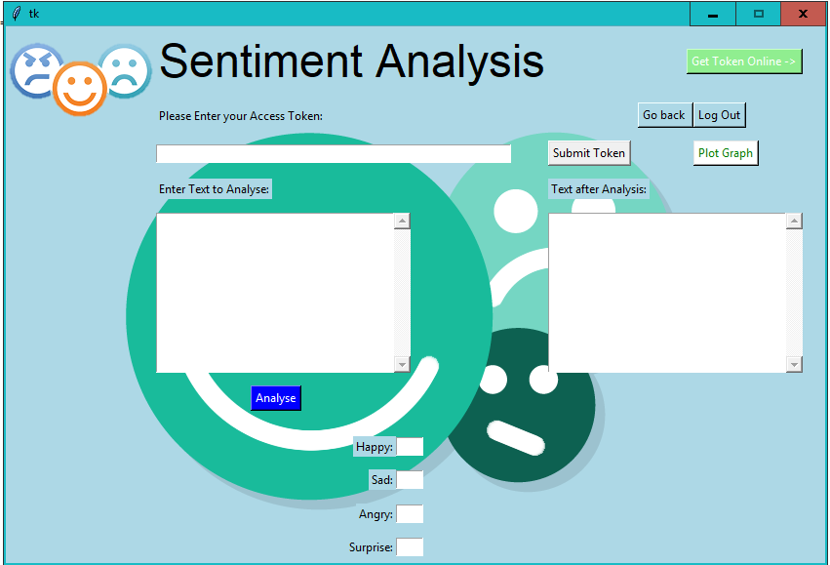
Linking of Application with Facebook

Slide 12
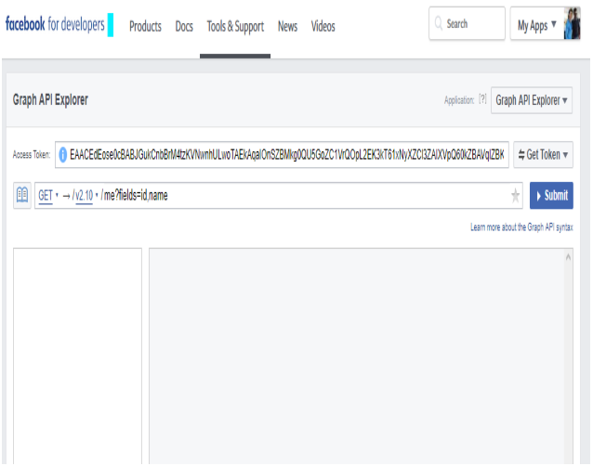
User Access Token

Slide 13
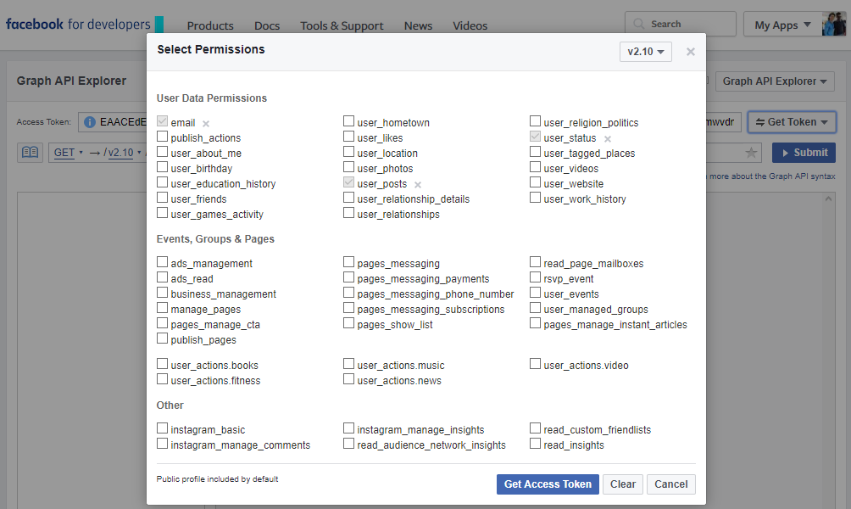
Facebook Data Access
Permission Page

Slide 14
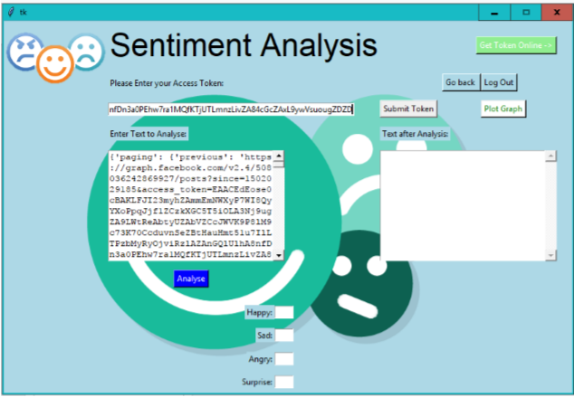
Fetched Facebook Posts

Slide 15
Thank You Presented By: Shivam, Sudhanshu

